Slide 1
Bond 2020
Community Update
Madison Elementary
Longfellow Middle School
Jefferson High School
Jan. 23, 2025

Slide 2
Purpose of Today’s Meeting
Bond 2020 Program Update
Major renovation updates for:
Longfellow Middle School
Jefferson High School
Madison Elementary
Facility Condition Assessment and master planning

Slide 3
Bond 2020 Approval
In November 2020, voters approved
two propositions totaling $1.3 billion:
PROP A
$1.21 billion for:
Campus renovations/upgrades, including HVAC upgrades
Security upgrades at all schools
Replacement of air-conditioning chillers more than 15 years old at schools not receiving major renovations
New school models
PROP B
$90 million for technology upgrades for all schools

Slide 4
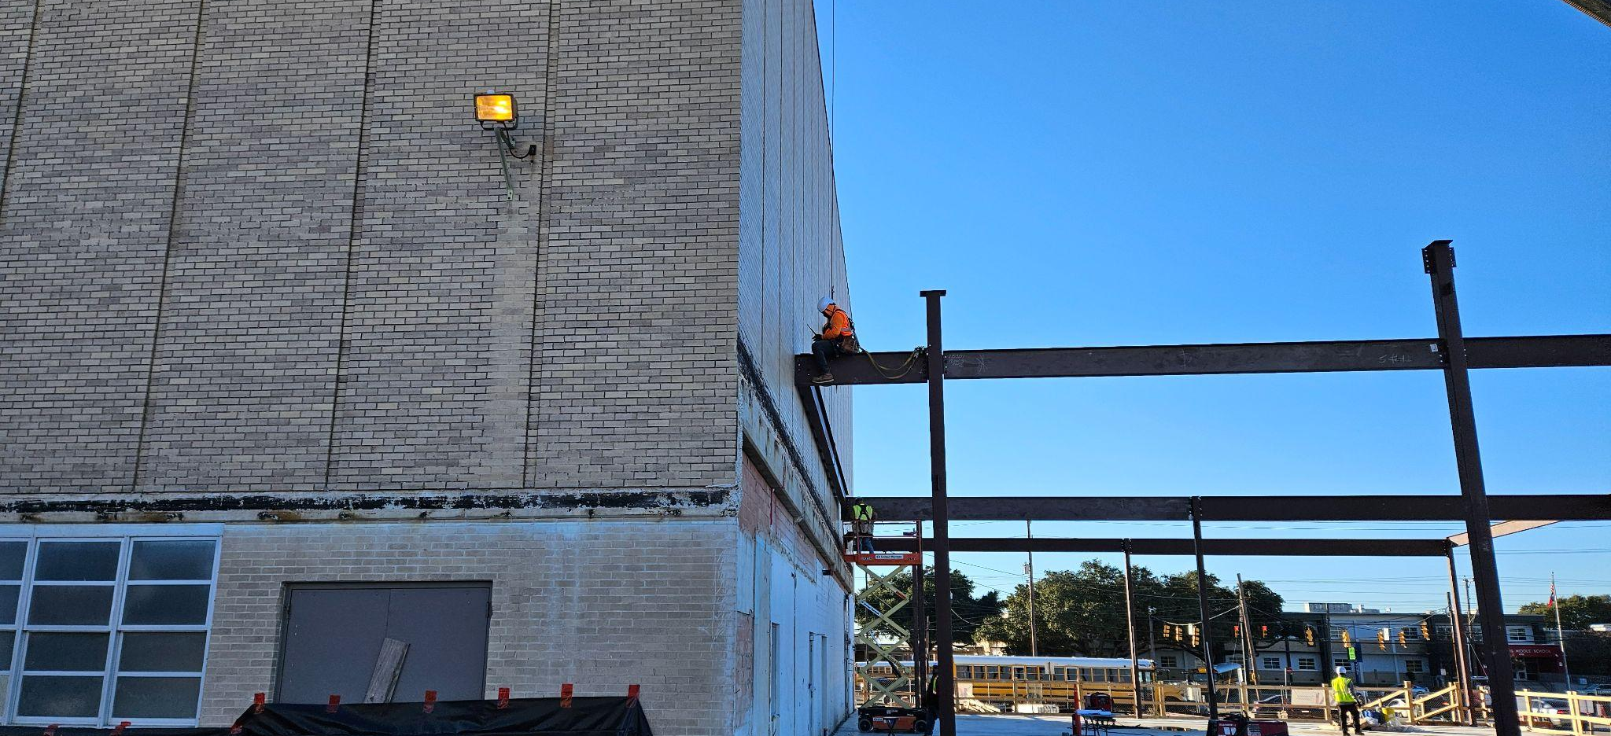
Bond 2020 Planning
Renovation projects were planned pre-pandemic using standard estimates
of 4%-5% for inflation

Slide 5
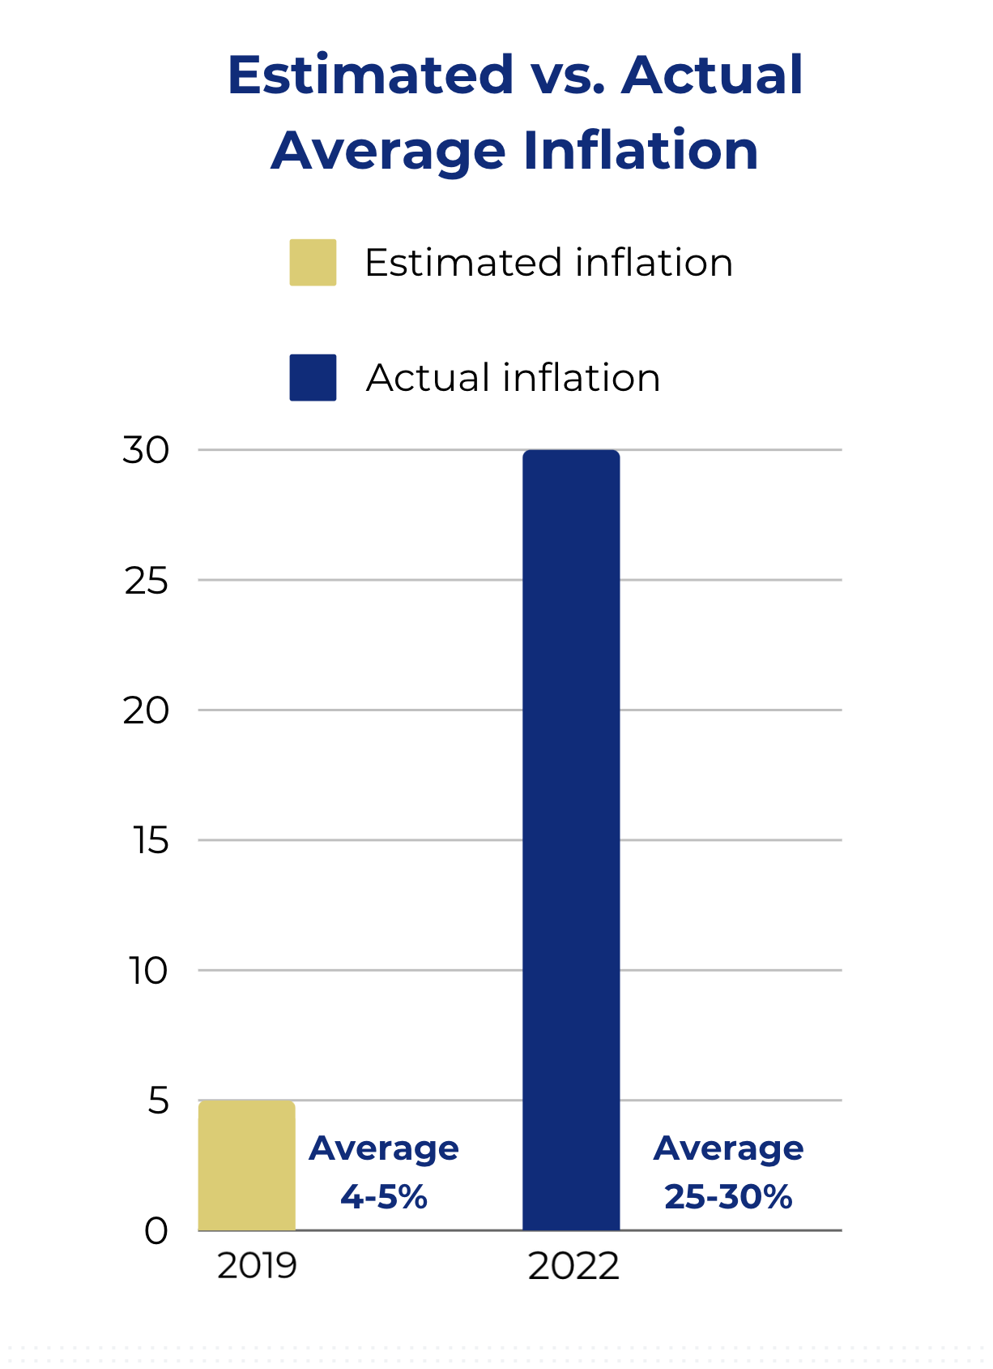
Pandemic Impacts
And then the global pandemic
hit, bringing with it significant construction pressures:
Unprecedented inflation
Average of 25-30%
Preliminary estimates for all projects came in over budget
Supply chain issues
Labor shortages

Slide 6
District Response
A tremendous amount of work went into salvaging Bond 2020:
Bond expenses examined at a program and a project level to identify savings
A number of program-wide cost-saving measures implemented
Example: project start dates staggered through phasing
Every major renovation project reviewed to get as close to budget as possible

Slide 7
How Can Bond Funds Be Used?

Slide 8
Rightsizing Impact
In 2023, the Board of Trustees voted on a plan to consolidate SAISD schools
Ripple effect on the bond program
7 of the campuses to be consolidated were slated for renovations (leaving 29 major renovations projects)
Receiving campuses had immediate needs to accommodate larger student populations

Slide 9
Funds From Canceled Bond Projects
Funds returned to the overall bond program for areas of critical need across the district, including at campuses receiving students through Rightsizing
The Bond 2020 Citizens Advisory Committee supported the use of returned bond funds for the following priority areas:
HVAC
Security upgrades
Restoration of scope to address critical needs

Slide 10
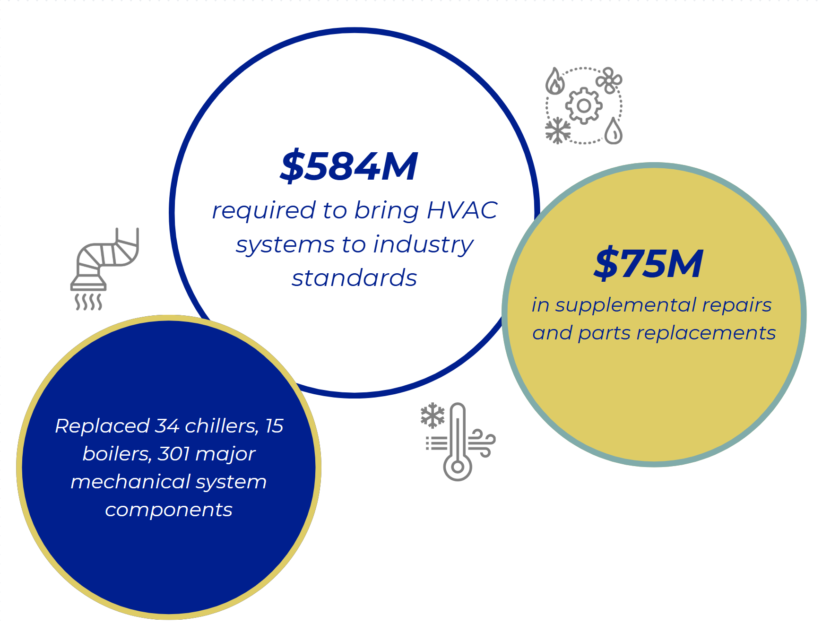
Significant HVAC Needs

Slide 11
Where We Are Today

Slide 12
Breakdown of Project Costs

Slide 13
Longfellow MS: Current Project Scope & Budget
Total Budget*: $49.6 million
Phase 2
Project
Scope:
Renovate academic building classrooms, special education, and collaborative spaces
New athletic building and field
New outdoor learning spaces
Renovate the theater
Convert gym to dance, makerspace, and discovery labs
Make drainage and culvert improvements
Targeted completion:
Spring 2026
*Includes architectural, engineering, surveys, permits, construction costs and FF&E

Slide 14
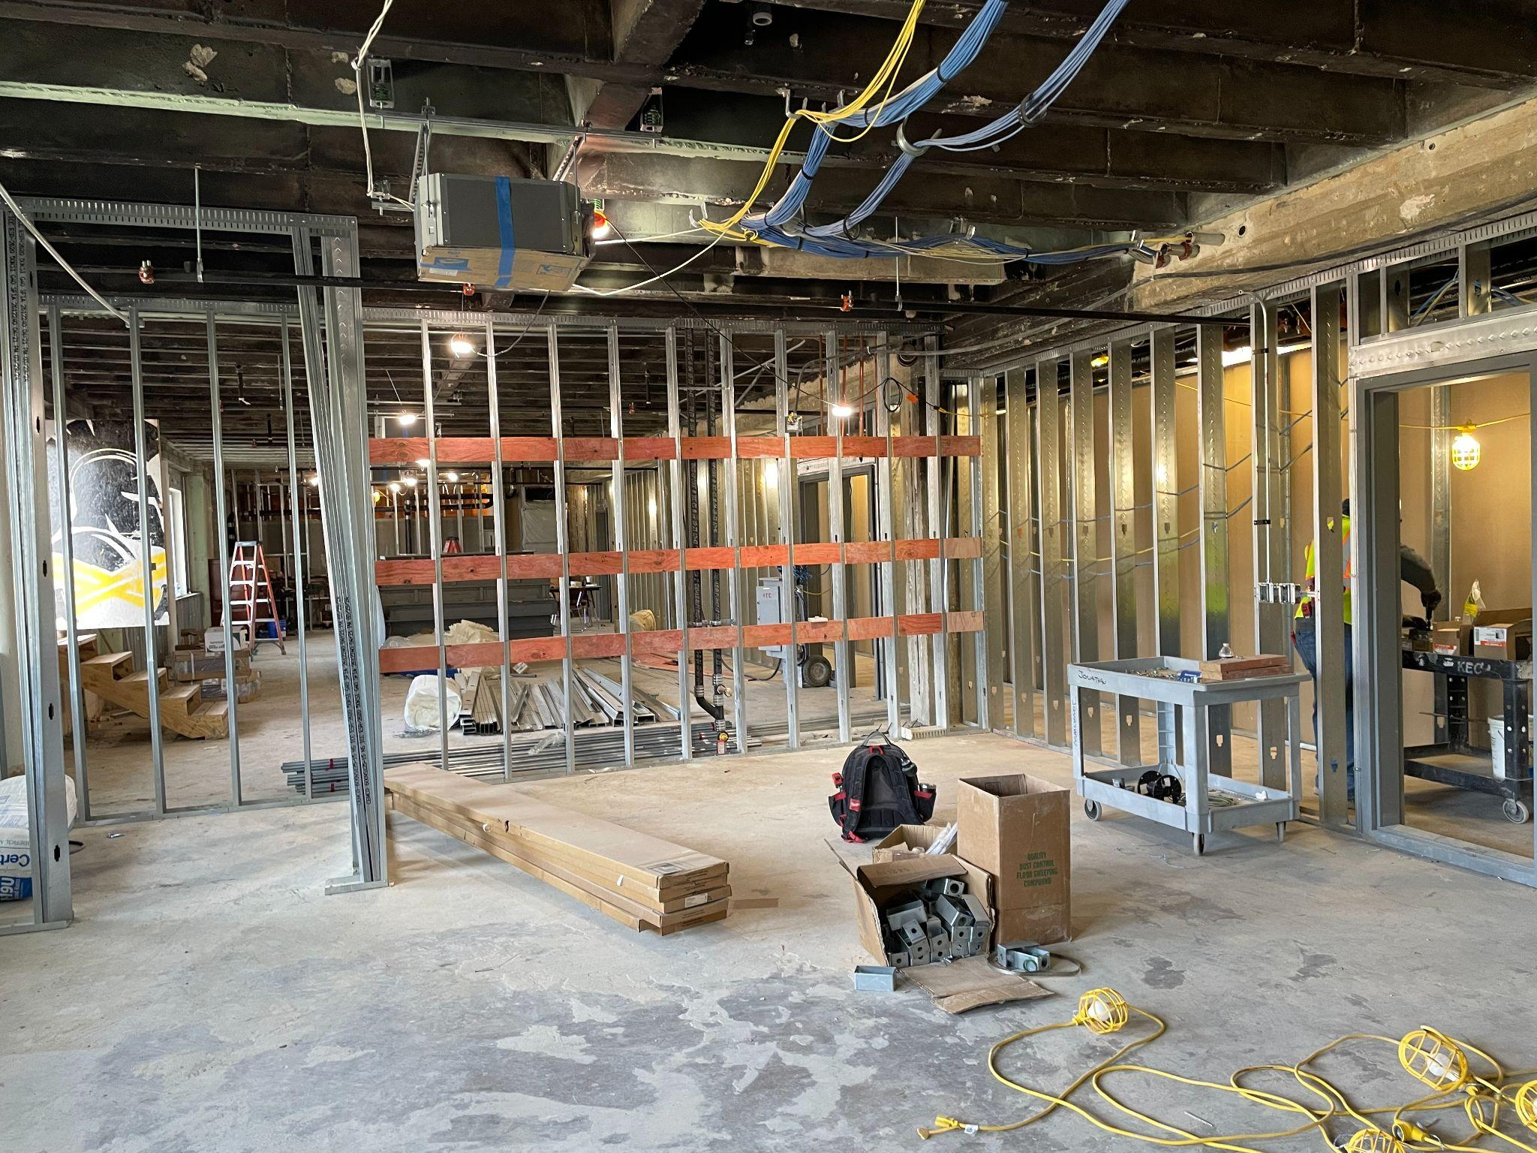
Longfellow MS Project Status
Overall project: 57% complete
Academic building: Renovation of east and west wings of 2nd and 3rd floors (12 new classrooms); work to be completed in summer 2025
New gyms: Building new gyms and auxiliary gym with new boys’ and girls’ locker rooms and weight room. Completion: summer 2025
Gym conversion: New dance studio, dance locker rooms, discovery labs, and speech room completed in summer 2025
Theater renovation: Completed in summer 2026

Slide 15
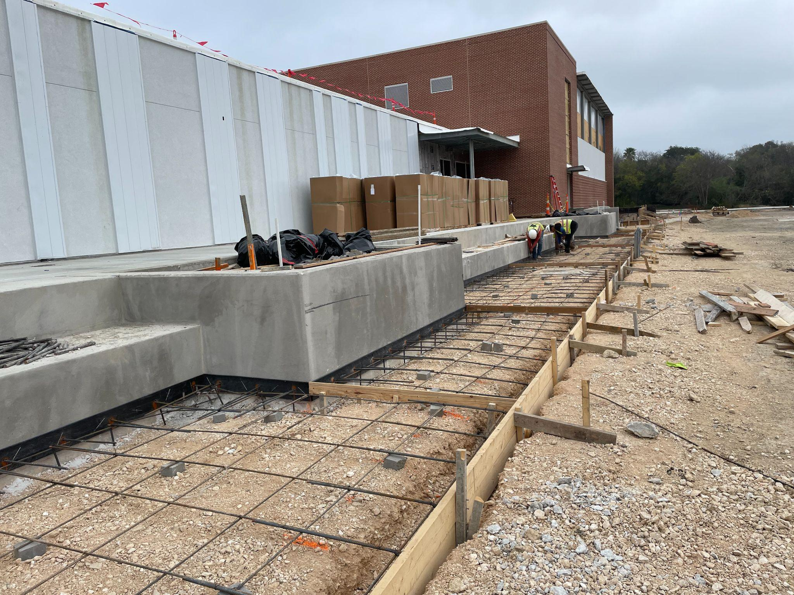
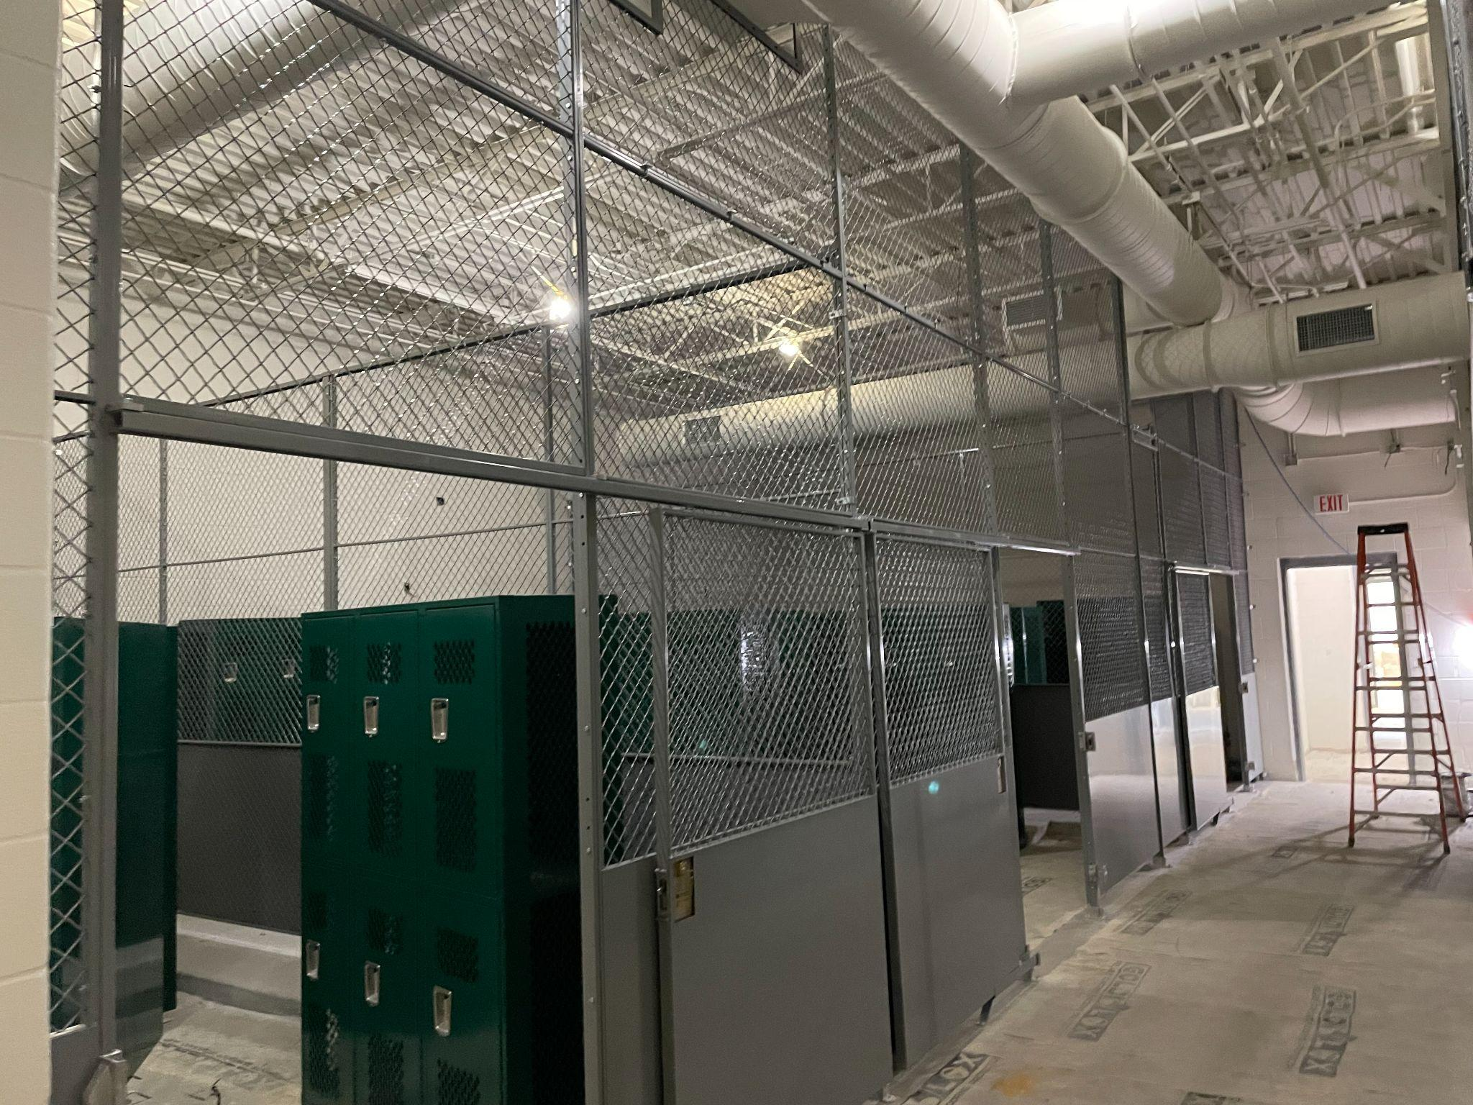
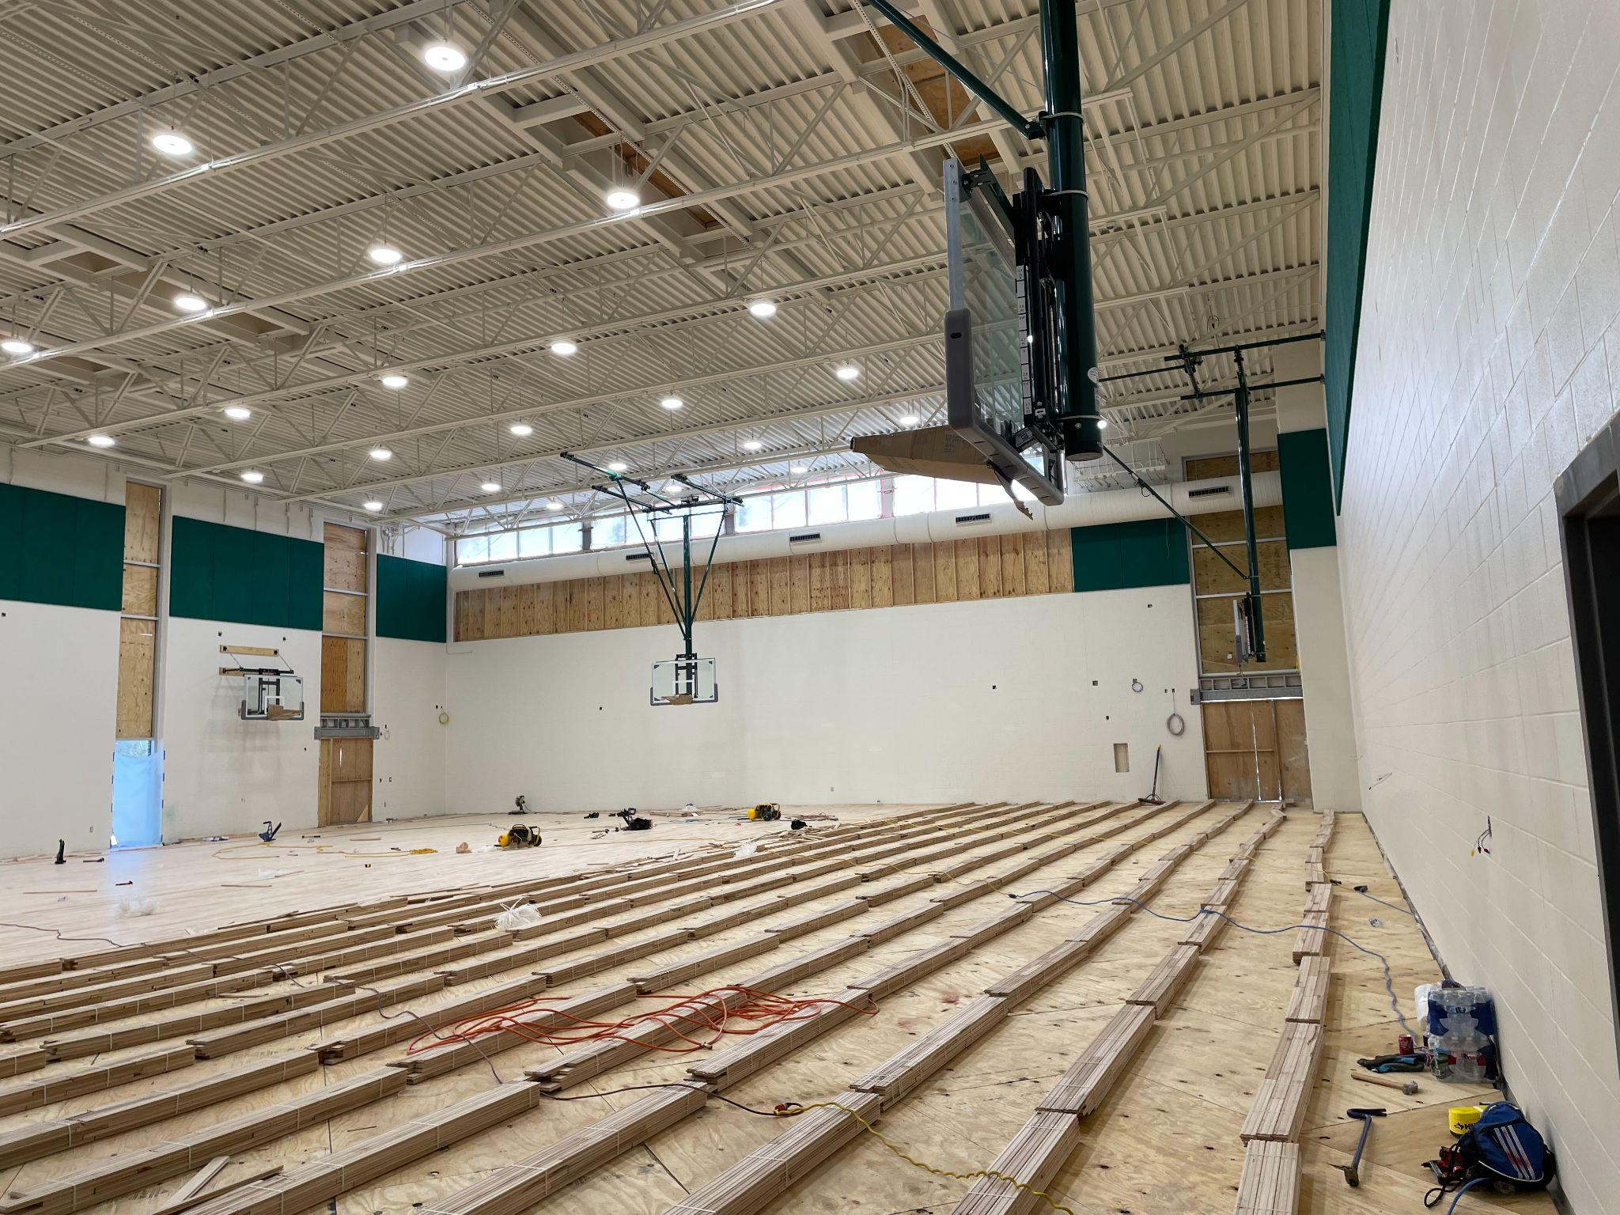
Longfellow MS Project Status

Slide 16
Jefferson HS: Current Project Scope & Budget
Total Budget*: $40 million
Phase 2
Project
Scope:
Restoration of original 1930's building exterior
Repair tennis court fencing
Interior historic restoration of library
Interior historic restoration of auditorium
Interior historic restoration of common spaces
Parking lot improvements
Athletic fields, track, and tennis court improvements
Targeted completion:
May 2026
*Includes architectural, engineering, surveys, permits, construction costs and FF&E

Slide 17
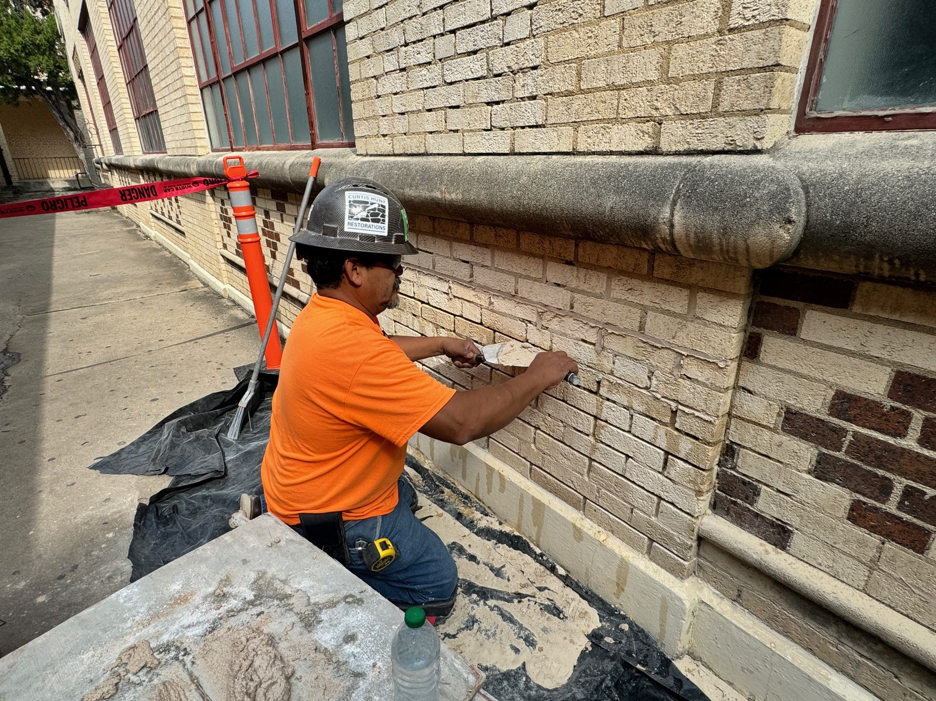
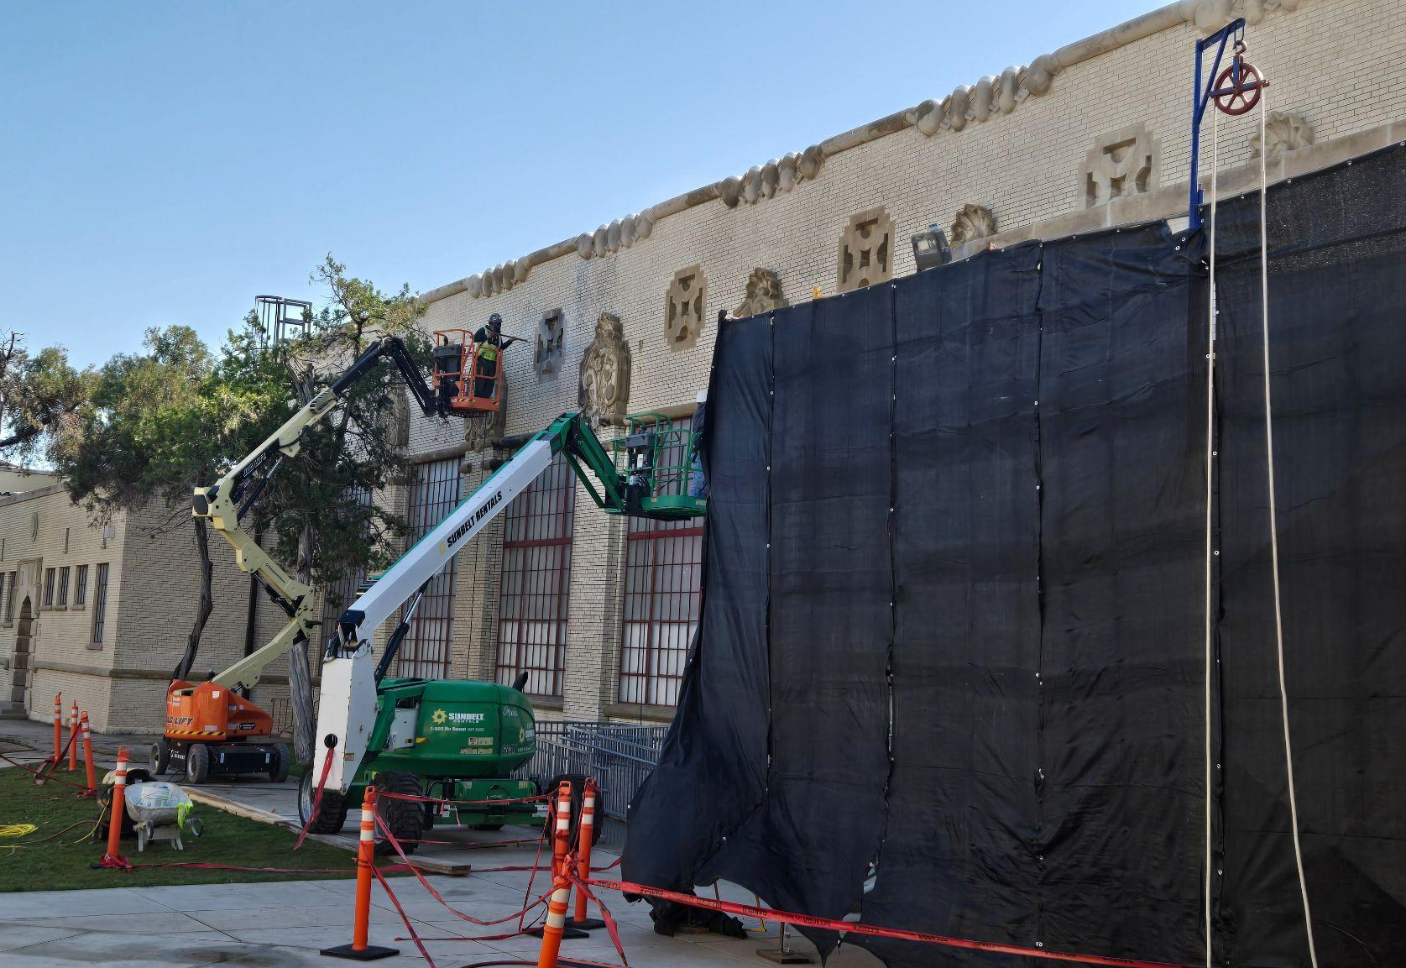
Jefferson HS Project Status
Overall project: 4% complete
1930’s building exterior: Existing historic masonry being clean, re-pointed, patched and repaired
Library restoration: Contractor is preparing for restoration work at the library
Auditorium restoration: In the process removing select historic elements for off-site restoration and abatement
Athletic improvements: Restoration of the Field House windows

Slide 18
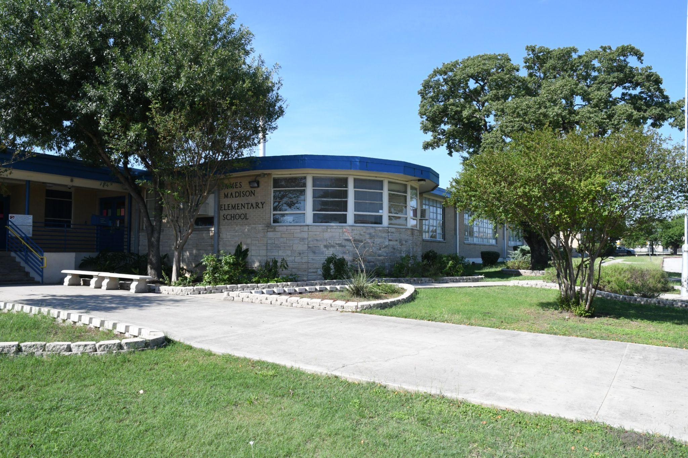
Madison ES: Current Project Scope & Budget
Total Budget*: $28.9 million
Scope:
New secured vestibule
New interior and exterior security cameras
New or replacement of outdoor learning opportunities
Renovate or gym and physical education classrooms
Re-paving and re-surfacing parking lots and driveways
Overhaul or replacement of all classrooms and science labs
Overhaul or replacement of special education classrooms
Overhaul or replacement of student dining and kitchen
Overhaul or replacement of main office and main entrance to include secures vestibule
Replace old exterior windows with new energy efficient windows in spaces receiving renovations
Complete overhaul and update to mechanical systems to the latest energy efficiency and indoor air quality standards.
*Includes architectural, engineering, surveys, permits, construction costs and FF&E

Slide 19
Phase 3 Projects
Most Phase 3 projects are
in the design phase
Madison is a Phase 3 project
Construction estimates for most Phase 3 projects exceed project budget
As we review Phase 3 projects, key factors to consider include next round of Rightsizing and SAISD Master Plan 2045

Slide 20
Next Round of Rightsizing
In May 2024, the Board of Trustees requested recommendations for next round of Rightsizing
SAISD still has more schools than it needs for current student population of about 44,000
Kicking off Master Plan 2045 to guide future downsizing efforts

Slide 21
About the Master Plan
Master Plan 2045 will provide significant data for each SAISD facility

Slide 22
Next Steps
Kick off the facility master planning process to chart a new way forward for facilities in SAISD
Capital Development & Construction Services will be following up with Madison principal to discuss formation of Project Advisory Team (PAT).

Slide 23
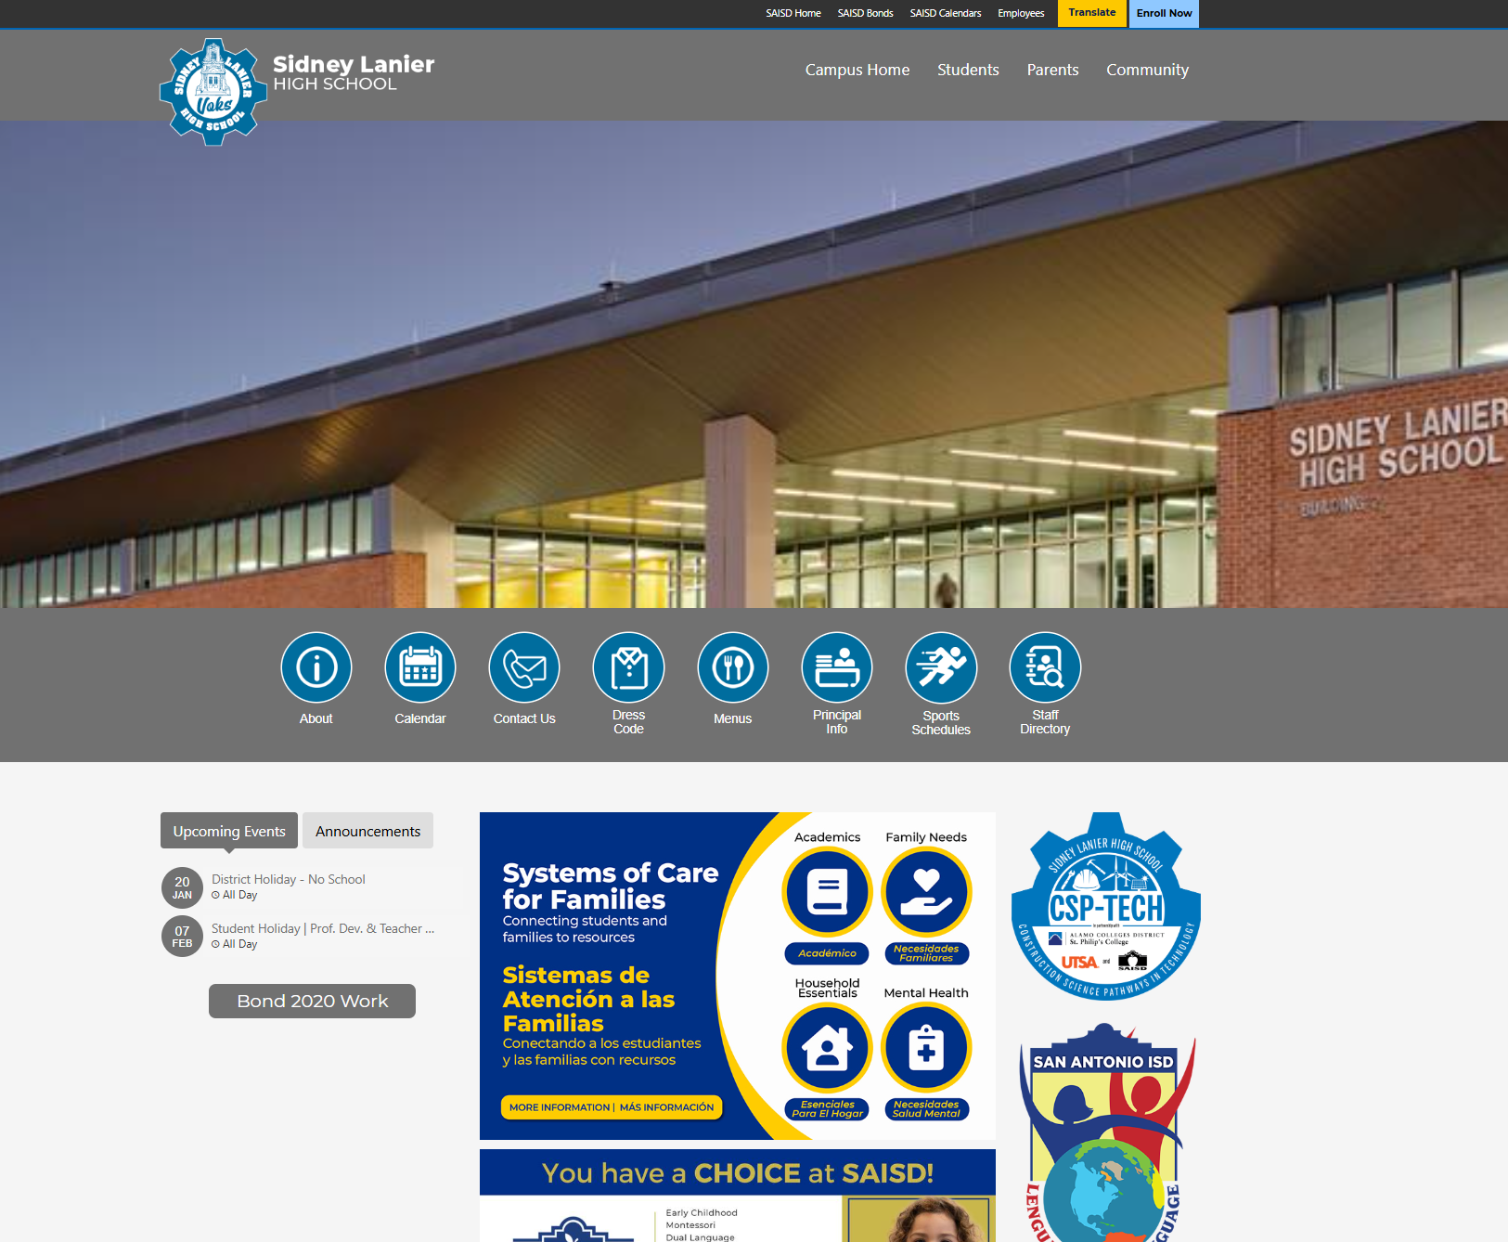
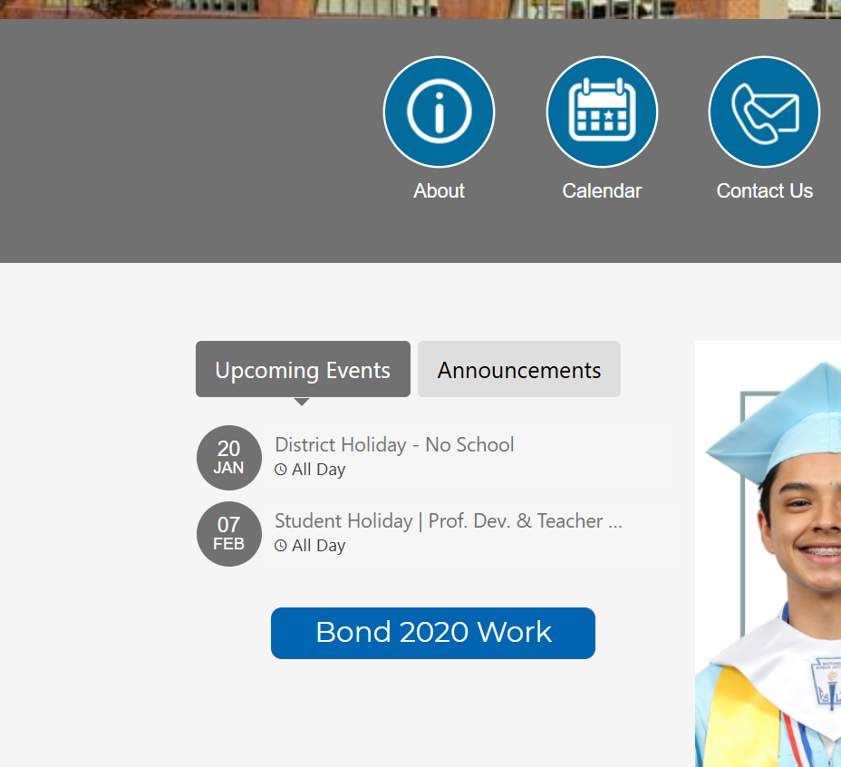
Bond Update & News
Bond.saisd.net For individual project updates, upcoming events, and more
Campus website Quick link to your school’s bond page via your campus homepage
Social media Follow SanAntonioISD on Facebook, Instagram, and LinkedIn for bond progress and event info

Slide 24
Questions

